Slide 1
ALTERNATIVE GOVERNANCE AND ELECTRICITY SERVICE STUDY - IMPERIAL IRRIGATION DISTRICT
DRAFT STUDY REPORT – MARCH 2023
Prepared For:
Riverside and Imperial County
Local Agency Formation Commissions

Slide 2
AGENDA
01.
Overview of the Draft Study Report
02.
Summary of Findings
03.
Suggested Actions
04.
Recap and Next Steps

Slide 3
STUDY OBJECTIVES RECAP
Evaluate potential alternative electrical service governance structures for IID and its extended service territory in the Coachella Valley.
Task 1
Task 2
Options for alternative governance structures that would extend voting rights to registered voters who reside within the IID electrical service area, allowing for proportional representation on a governing board that has primary jurisdiction on all electrical service matters.
Options for providing continued publicly and/or independent system operator owned and managed electrical service to IID service area customers.

Slide 4
Executive Summary
REPORT ORGANIZATION
Electrical Service Overview for the Coachella Valley
Energy Service Stakeholders
Results were summarized into the following main sections to facilitate ease of use and assist with ongoing discussions.
Utility Ownership Models
Study Approach and Analysis
Alternative Electrical Service Options
Findings and Suggested Actions

Slide 5
ELECTRIC SERVICE OVERVIEW
IID Extends Electric Services
Electric service boundary expanded to Coachella Valley after purchasing assets from California Electric Power Company.
Boulder Canyon Project Act Enacted
Authorized the Construction of the All-American Canal
IID Energy Division in 2023
05
Today, IID manages an annual operating budget of over $520 million and responsible for 1.2 gigawatts of generation and power purchases, 20 megawatts of storage, over 125 substations, 1,800 miles of transmission lines, and 6,100 miles of distribution lines.
02
Agreement of Compromise Executed
Authorized IID to service and sell electricity in Coachella Valley Water District’s (CVWD’s) territory. Allowed IID to lease CVWD’s hydro power right opportunities for 99-years.
06
IID Entered Electric Business
IID’s Lease of Hydro Power Rights Ends
03
IID Established
One of two energy service provider for Imperial County, in direct competition with Cal Electric
Service Boundary Agreement
Water Service Provider for Imperial County
Agreement between S. Cal Edison (formerly Cal Electric) and IID dividing Coachella Valley for non-compete service areas. Renewed approximately every 25-years (renewed in 1967, 1992, 2018).
According to the conditions of the Agreement of Compromise.
04
01
07
1911
1928
1934
1936
1943
2023
2033

Slide 6
ENERGY SERVICE STAKEHOLDERS
Cove Communities Services Commission

Slide 7
OVERVIEW OF UTILITY OWNERSHIP MODELS
Investor-Owned Utility (IOU)
Electric Cooperative (Co-Op)
State governed, for-profit private entity providing service in franchised areas. Regulated by California Public Utilities Commission (CPUC).
Locally governed, not-for-profit private entity formed for the sole purpose of transmitting or distributing electricity exclusively to its stockholders or members at-cost. Regulated by the CPUC.
Municipal Utility
Community Choice Aggregators (CCA)
Locally governed, non-profit organization created by voter approval. Regulated by City Council or elected commission.
Locally governed within IOU service area, not-for-profit private entity formed for the sole purpose of securing power exclusively to its stakeholders or members at-cost.
Public Utility District
Joint Powers Authority/Agency (JPA)
Locally governed, non-profit organization created for specific public services. Operate under a principal act or a special act. Regulated by elected or appointed Board of Directors.
Locally governed, non-profit organization created by two or more public agencies for a specific range of common public services within geographically defined area. Operate under a Joint Exercise of Powers Act. Regulated by either elected or appointed Board of Directors.

Slide 8
STUDY APPROACH AND ANALYSIS
Development of Alternative Governance Structures consisted of the following actions:
Develop stakeholder-driven evaluation criteria.
Present foundational differences between models.
Conduct extensive outreach
Identify practical alternatives.

Slide 9
ENERGY SERVICES STAKEHOLDER FEEDBACK
Local Representation and Local Control
Top priority regardless of option.
Publicly owned and governed with flexible structure.
System Reliability
East Coachella Valley experiences frequent/prolonged outages.
Aging facilities and capacity limitations system wide.
Economic Development
Unable to accommodate growth and new development.
Unclear how overdue capital improvements will be funded.
Improvements with planning and implementation process needed.
Industry Trends
Concerns with electrification and achieving renewable goals.
Limited local power program offerings, i.e. rooftop solar, etc.
Affordability
Uncertain how existing customer rates will be impacted.
Cost to form new entity and/or energy utility.

Slide 10
STAKEHOLDER-DRIVEN FOUNDATION OBJECTIVES
The following objectives were established to aid in the review and assessment of each Alternative Option.
Public and Local Governed Entity
Provides Representation
Maintain Advisory Role
Flexible Financing Opportunities
Ability to Own Assets
Financial Policy Oversight
Capital Planning Oversight
Structure Easy to Implement
Expands Public Benefits
Achieve Industry Standards
Use of Efficient Public Resources
Promotes Local Energy Programs
Achieve Vertically Integrated Status
Ability to Adapt
Minimizes Financial Risk
Local Control of Distribution Assets
Maximize Public Involvement
Notes:
Mention CIP common to all option – for financing opportunities..est. at $800m for IC and CV.

Slide 11
Alternative
Option 1:
IID Continues to Provide Service
The following option are not exclusive and indented to provide a general indication of the best-suited alternatives for consideration.
Option 1.A
Maintain status quo.
Option 1.B
Annex Coachella Valley service territory into IID and adjust jurisdictional boundary.
Option 1.C
Create IID sub-Board of Directors for Coachella Valley electrical service oversight.
Option 1.D
Establish a Joint Powers Authority
(Note 1)
(Note 1)
(Note 1)
Note (1) Option does not change IID’s water service boundary, water services to remain under the sole responsibility of the current IID Board of Directors.

Slide 12
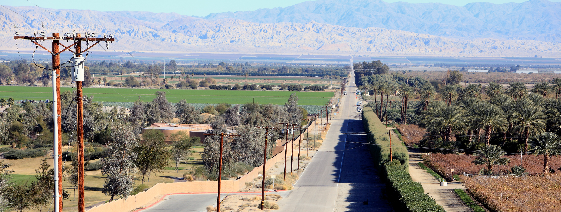
Alternative Option 2:
IID Terminates Electric Service
The following option are not exclusive and indented to provide a general indication of the best-suited alternatives for consideration.
Option 2.A
Dissolution and Merger with Investor-Owned Utility.
Option 2.B
Form a New Utility District with specific roles.
Option 2.C
Form a New Vertically Integrated Utility District
Option 2.D
Form a Community Choice Aggregation
(Note 1)
(Note 1)
(Note 1)
(Note 1)
Note (1) Option does not change IID’s water service boundary, water services to remain under the sole responsibility of the current IID Board of Directors.

Slide 13
SUMMARY OF FINDINGS
Several Alternative's support many stakeholder-driven Foundational Objectives, except for the following:
Ability to Achieve Vertically Integrated Utility Status
Structure Easy to Implement
Ability to Adapt to Future Changes
Proposed structure should have limited legal, financial, and legislative complexity as compared to status quo.
A utility structure that could be expanded to provide the greatest regulatory control over all aspects of electricity service.
Structure that can be modified to align with future changes in members roles, utility responsibilities and/or governance.

Slide 14
SUGGESTED ACTIONS PRIOR TO EXPIRATION OF THE AGREEMENT OF COMPROMISE
The following can assist with establishing near-term priorities for alternatives under consideration:
Acknowledge that CVEC has promoted collaboration and effective at advancing development on this issue.
Establish roles, rights and responsibilities for electrical service in Coachella Valley.
Develop policy principles to provide a consistent basis for evaluating issues, making decisions, and setting policy.
Perform necessary technical feasibility and financial evaluations.

Slide 15
Aug 30, 2023
Public Review Period Closes
Submit written comments to LAFCO by this Date
Meeting Recap and Next Steps
Nov 30, 2023
Closing Remarks and Observations
Final Study Report Due

