Slide 1
FINAL BUDGET
FISCAL YEAR 2025-2026
May 22, 2025
Tyler salcido, executive officer

Slide 2
PURPOSE OF FINAL BUDGET
As required by the Cortese-Knox-Hertzberg Act, LAFCo must adopt an annual budget
Adopt preliminary budget by May 1, final by June 15
Ensures operational funding for the next fiscal year
Updates March draft (lower pension bond contribution rate)

Slide 3
BUDGET OVERVIEW
Total Budget: $886,419
Increase: $15,177 (1.74%) from FY2024-2025
Decrease vs. Draft (March 27): ($20,023) (pension bond contribution rate from 6.04% 1.0828%)

Slide 4
TWO FUNDING SCENARIOS
(A) No Minimum Unassigned Reserves
Contributions 1.74% / Reserve draw $96,873
Unassigned balance $76,793
(B) Maintain 10% Unassigned Reserves
Contributions 3.51% / Reserve draw $85,024
Unassigned balance $88,642 (10%)

Slide 5
REVENUE BREAKDOWN
City Contributions: $341,129 (A) / $347,054 (B)
County Contribution: $341,129 (A) / $347,054 (B)
LAFCo Fees $38,000
Rental Income $51,288
Interest Income: $18,000

Slide 6
RESERVES & CONTINGENCY
Assigned Emergency Reserves $500,000
- Litigation Fund $40k / Building Damage $460k
Unassigned after budget:
- $ 76,793 (A) / $88,642 (B)

Slide 7
PROJECTED RESERVES (A)
Moderate use of reserves, maintains higher balance for future flexibility
797,105 | Total Reserves as of 6.30.2024
(103,623) | Use of Reserves FY2024-2025
(19,816) | Est. Add. Reserves FY2024-2025
(500,000) | Assigned Emergency Reserves
173,666
(96,873) | Use of Reserves FY2025-2026
76,793 | Additional Unassigned Reserves

Slide 8
PROJECTED RESERVES (B)
Moderate use of reserves, maintains higher balance for future flexibility
797,105 | Total Reserves as of 6.30.2024
(103,623) | Use of Reserves FY2024-2025
(19,816) | Est. Add. Reserves FY2024-2025
(500,000) | Assigned Emergency Reserves
173,666
(85,024) | Use of Reserves FY2025-2026
88,642 | Additional Unassigned Reserves

Slide 9
EXPENDITURES OVERVIEW
Salaries: $434,099
Employee Benefits: $206,522
Communications: $1,200
Liability & Property Insurance: $24,533
Maintenance – Equip: $6,000
Memberships: $6,159

Slide 10
EXPENDITURES OVERVIEW Cont.
Office Supplies: $8,000
Electronics $12,000
Software & Licenses: $7,000
Legal Services: $30,000
Audit & Payroll Services: $23,000
Data Processing/Network: $30,138

Slide 11
EXPENDITURES OVERVIEW Cont.
GIS/CAED: $12,000
Equipment Leases/Rent: $4,092
Misc. Expenses: $1,000
Travel: $27,976
In County: $250
Out of County: $27,726

Slide 12
EXPENDITURES OVERVIEW Cont.
Capital Outlay: $0
Repairs & Maint. – Ongoing Expenses: $20,000
Repairs & Maint. – Remodel: $0
Utilities: $23,100

Slide 13
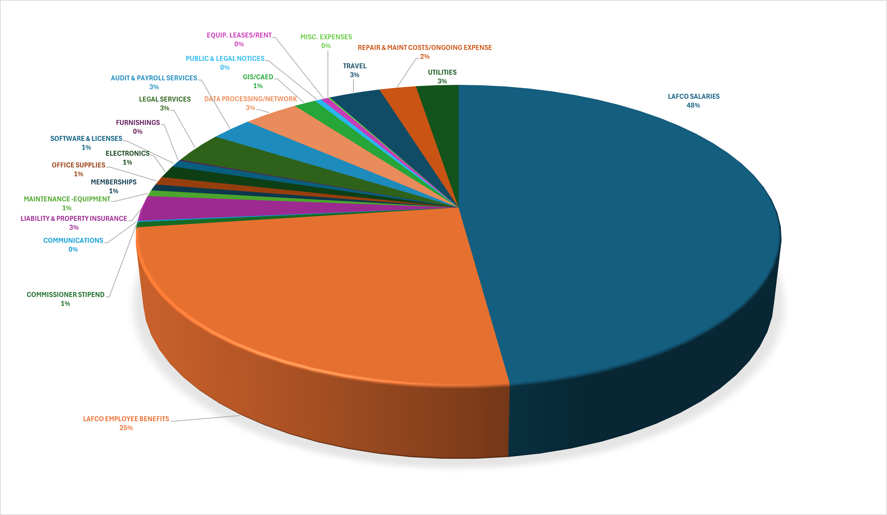
FY2025-2026 LAFCO EXPENDITURES
SALARIES/BENEFITS 72%

Slide 14
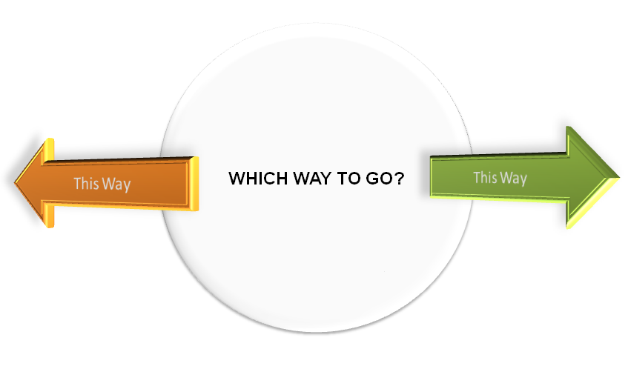
SCENARIO TRADE-OFFS
(A) No Minimum Unassigned Reserves: Lower agency cost, smaller unassigned reserves.
(B) 10% Minimum Unassigned Reserves: Meets 10% reserve target, higher contributions.
Both keep $500k Assigned Reserves intact.

Slide 15
COMMISSION OPTIONS
Option #1: Adopt Scenario A (No Minimum Unassigned Reserves)
Option #2: Adopt Scenario B (10% Unassigned Reserves)
Option #3: Adopt budget with Commission amendments

Slide 16
EO RECOMMENDATION
Conduct public hearing, consider feedback
Adopt Option 2 – Scenario B
- Preserves prudent 10% unassigned reserve while funding operations.

Slide 17
Questions or Comments

